Slide 1
Bash Command Basic Conda Environment
Marlabs

Slide 2
Find out your current working directory:
pwd
Get a listing of what files are in the current directory:
ls
Change directory to the path specified:
cd

Slide 3
. Refer to the current directory ./project
.. Move up one fold cd ..
../../my_folder Move up multiple levels cd ../../my_folder
Make directories
mkdir my_folder
Open the file in your terminal
cat my_file

Slide 4
Remove files and folders:
rm my_folder
References:
https://programminghistorian.org/en/lessons/intro-to-bash
https://medium.com/the-code-review/top-10-bash-file-system-commands-you-cant-live-without-4cd937bd7df1

Slide 5
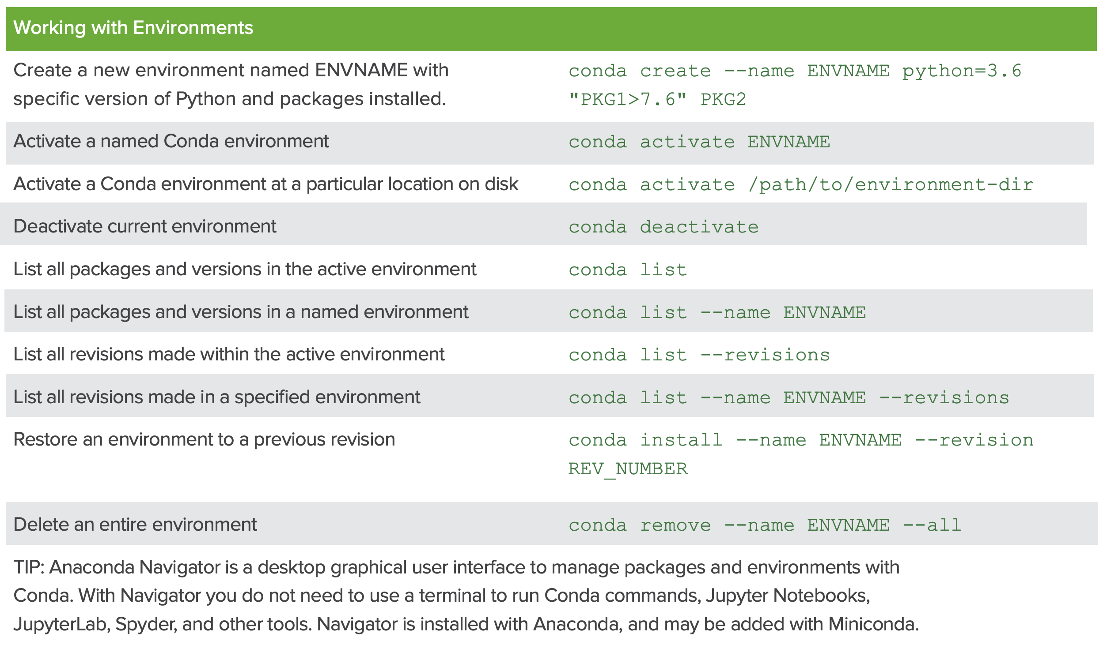
Conda Managing Environments

Slide 6
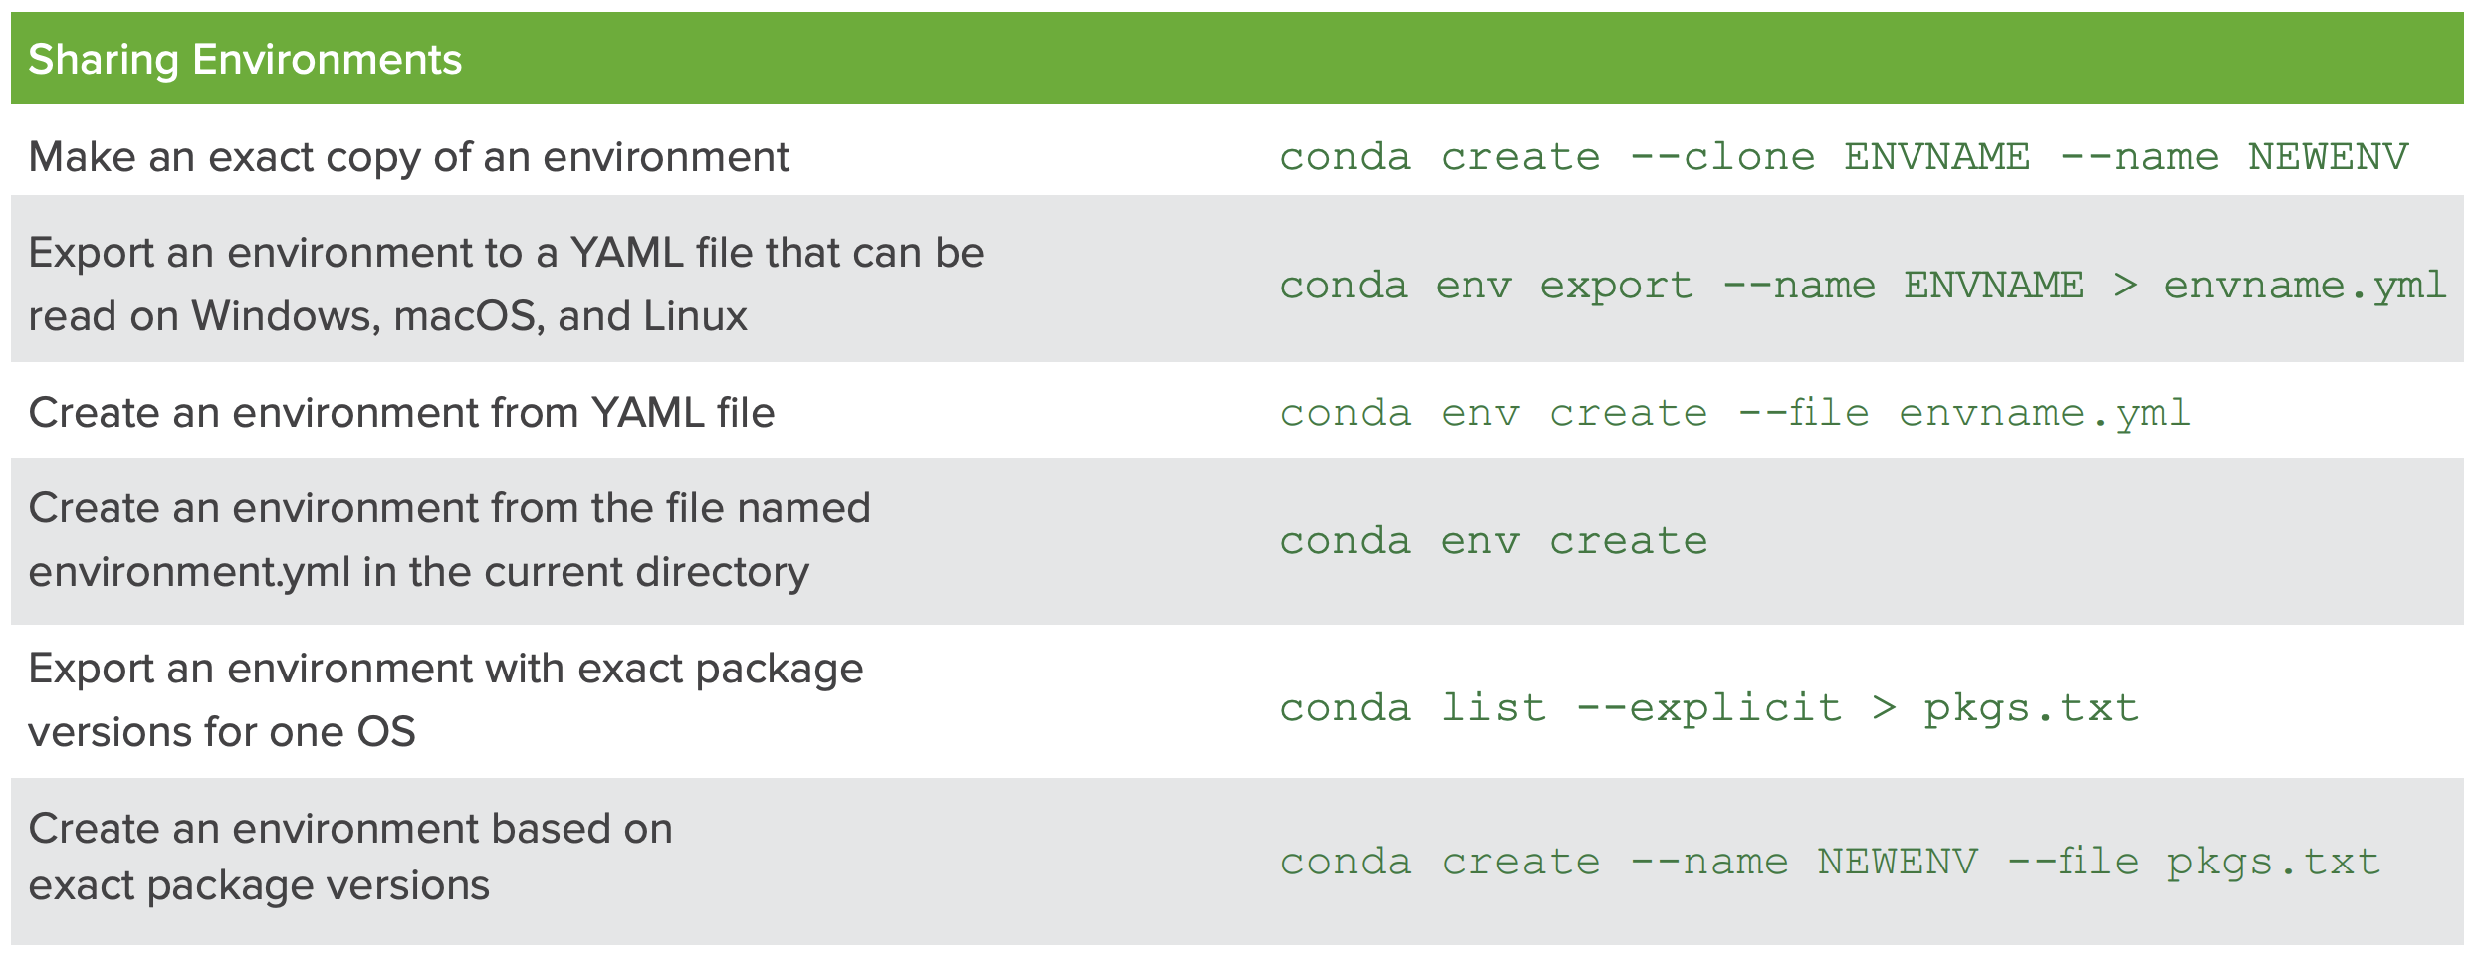
Conda Managing Environments

